Slide 1


<Homa Sarlak>
<2023-07-21>

Slide 2

Outline
Executive Summary
Introduction
Methodology
Results
Conclusion
Appendix

Slide 3
Executive Summary
Summary of methodologies
Data Collection through API
Data Collection with Web Scraping
Data Wrangling
Exploratory Data Analysis with SQL
Exploratory Data Analysis with Data Visualization
Interactive Visual Analytics with Folium
Machine Learning Prediction
Summary of all results
Generated dataset using API and scraping Wikipedia
Result of data exploration using SQL
Built an Interactive Dashboard with Ploty Dash
Result of Predictive Analytics

Slide 4
Introduction
Project background and context
SpaceX advertises Falcon 9 rocket launches on its website, with a cost of 62 million dollars; other providers cost upward of 165 million dollars each, much of the savings is because SpaceX can reuse the first stage. Therefore if we can determine if the first stage will land, we can determine the cost of a launch. This information can be used if an alternate company wants to bid against SpaceX for a rocket launch
Problems you want to find answers
- What factors we need to consider to have a successful landing
- What is the interaction between features that determine the success of landing
- What operating factors we need to consider to have a successful landing

Slide 5

Section 1

Slide 6
Methodology
Executive Summary
Data collection methodology:
Data was collected using SpaceX API and web scraping from Wikipedia website
Perform data wrangling
Used One hot encoder to display all features and their encoded ones
Perform exploratory data analysis (EDA) using visualization and SQL
Perform interactive visual analytics using Folium and Plotly Dash
Perform predictive analysis using classification models
1. Create a column for the class 2. Standardize the data
3. Split into training data and test data 4. Find the method performs best using test data
5. Find best Hyperparameter for SVM, Classification Trees and Logistic Regression
-

Slide 7
Data Collection
Describe how data sets were collected
Data collected using get request to the SpaceX API
Next, we decoded data as a Json using .json() function and turn it into a pandas dataframe using .json_normalize().
Data was cleaned, and missing value substituted by the mean
Data also collected using web scraping from Wikipedia for Falcon 9 launch records with BeautifulSoup library
Recorded as HTML table, parse the table and convert it to a pandas dataframe for future analysis

Slide 8
Prepared Data for analysis
Data collection using SpaceX API
Data collection using web scraping
Data preprocessing
Decoded data as a Json
Parsing the launch HTML tables
Create Pandas
dataframe

Slide 9
Data Collection – SpaceX API
The GitHub URL of the completed SpaceX API calls:
https://github.com/Homa777/Applied-data-science-capston-course/blob/main/Data%20collection_API%20Falcon%209.ipynb
We used the get request to the SpaceX API to collect data, clean the requested data and did some data wrangling and formatting

Slide 10
Data Collection - Scraping
Present your web scraping process using key phrases and flowcharts
We applied web scrapping to webscrap Falcon 9 launch records with BeautifulSoup
We parsed the table and converted it into a pandas dataframe
The GitHub URL of the completed web scraping:
https://github.com/Homa777/Applied-data-science-capston-course/blob/main/Data%20Collection%20using%20web%20scrapping%20.ipynb

Slide 11

Data Wrangling
Describe how data were processed:
Performed exploratory data analysis and determined the training labels
Calculated the number of launches at each site, and the number and occurrence of each orbits
Created a landing outcome label from Outcome column to determine the success rate
Exported the result into CSV file
The GitHub URL of completed data wrangling:
https://github.com/Homa777/Applied-data-science-capston-course/blob/main/Data%20wrangling.ipynb

Slide 12
EDA with Data Visualization
Summarize what charts were plotted and why you used those charts
Visualized the relationship between following variables to get insight from data
- Flight number and launch Site
- Payload and launch site
- Success rate of each orbit type
- Flight number and orbit type
- Launch success yearly trend
Add the GitHub URL of your completed EDA with data visualization:
https://github.com/Homa777/Applied-data-science-capston-course/blob/main/EDA%20with%20Data%20visualization%20.ipynb

Slide 13
EDA with SQL
Summarize the SQL queries you performed
The names of unique launch sites in the space mission
The total payload mass carried by boosters launched by NASA (CRS)
The average payload mass carried by booster version F9 v1.1
The total number of successful and failure mission outcomes
The failed landing outcomes in drone ship, their booster version and launch site names.
GitHub URL: https://github.com/Homa777/Applied-data-science-capston-course/blob/main/jupyter-labs-eda-sql-coursera_sqllite.ipynb

Slide 14
Build an Interactive Map with Folium
The object we calculated:
Failure or success assigned to class 0 and 1. (0) for failure and 1 for success
Found which launch sites have relatively high success rate using clustering
Distance between launch sites and its proximities
Why we calculate distance between launch sites to its proximities?
To see if launch sites are near railways, highways or cities
Github: https://github.com/Homa777/Applied-data-science-capston-course/blob/main/Folum.ipynb

Slide 15
Build a Dashboard with Plotly Dash
Plots/graphs and interactions added to a dashboard:
1- Pie charts
Reason:
To show the total launches by a certain sites
2- Scatter graph
Reason:
To show the relationship with Outcome and Payload Mass (Kg)
Github: https://github.com/Homa777/Applied-data-science-capston-course/blob/main/app_ploty_dash.py

Slide 16
Predictive Analysis (Classification)
GitHub: https://github.com/Homa777/Applied-data-science-capston-course/blob/main/Pediction.ipynb
load data using numpy and pandas
Testing data
Standardize data
Use Accuracy as metric
Training data
Built ML model and define hyperparameters using GridSearchCV
Logestic regression
Best classification model is DT
SVM
decision tree
KNN

Slide 17
Results
Exploratory data analysis results
Interactive analytics demo in screenshots
Predictive analysis results

Slide 18

Section 2

Slide 19
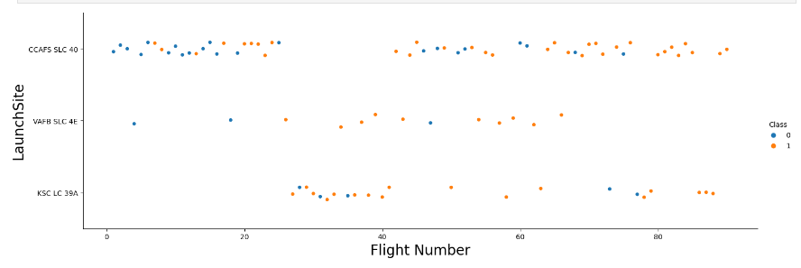
Flight Number vs. Launch Site
Scatter plot of Flight Number vs. Launch Site. The Scatter plot shows that as the flight number increase, the success rate got bigger.

Slide 20
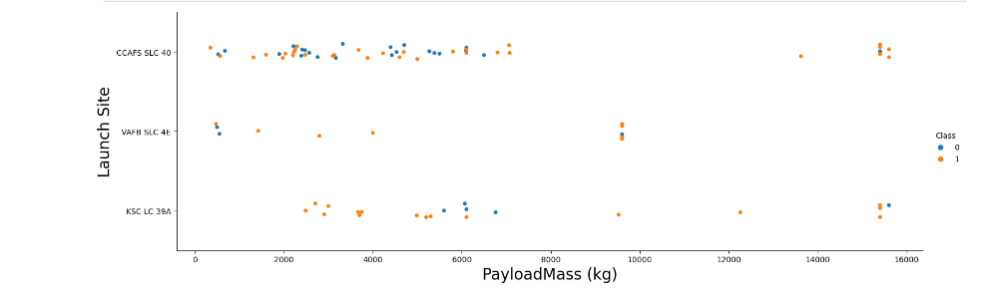
Payload vs. Launch Site
As we can see for the launch site (CCAFS SLC 40), the success rate substantially increased as payload mass went up

Slide 21
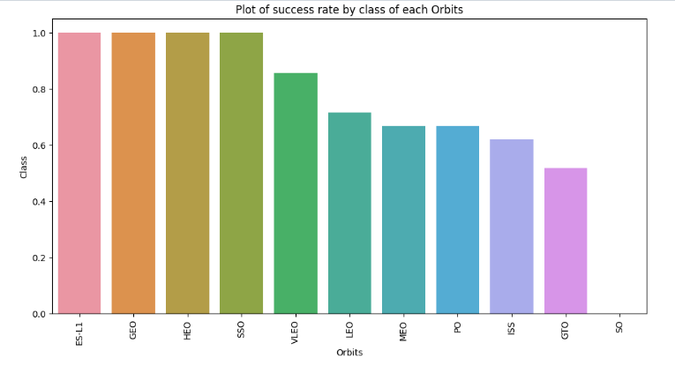
Success Rate vs. Orbit Type
The plot shows the most successful orbit type

Slide 22
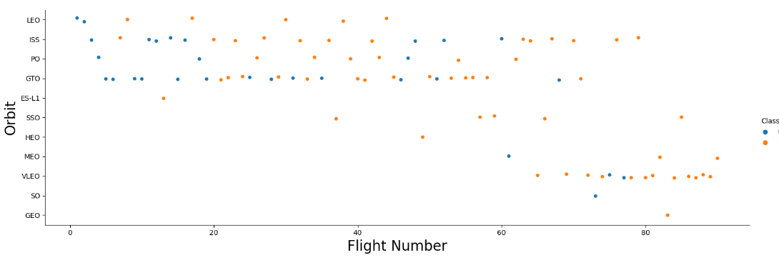
Flight Number vs. Orbit Type
Success rate in LEO orbit = There is relationship between flight number and the orbit
Success rate of GTO, PO and ISS orbit = There is no relationship between flight number and the orbit

Slide 23
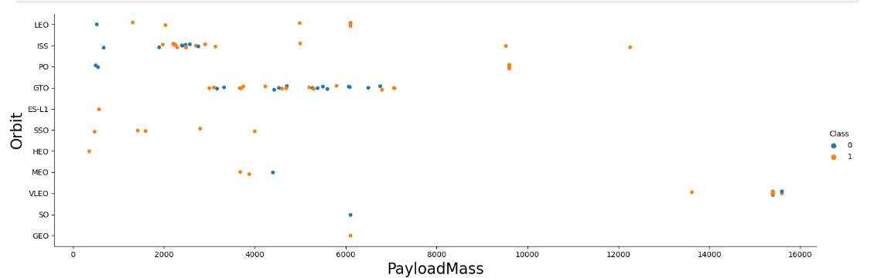
Payload vs. Orbit Type
The plot shows the successful landing are more for SSO, LEO and ISS orbits

Slide 24
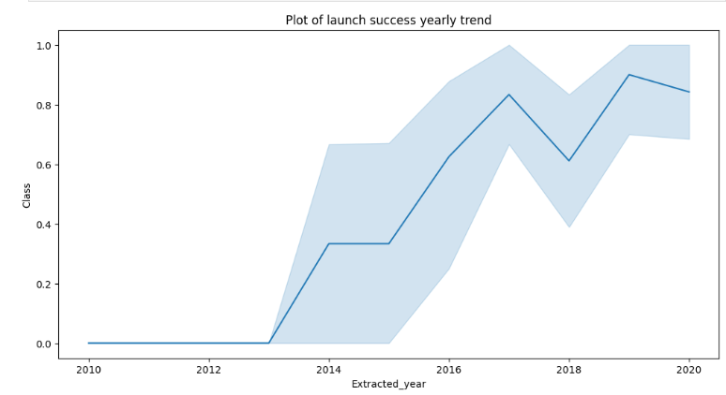
Launch Success Yearly Trend
The success rate after year 2013 overall increased with unnoticeable decrease

Slide 25
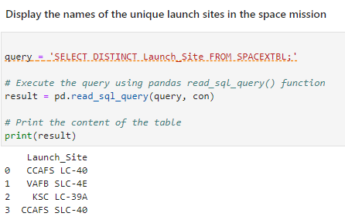
All Launch Site Names
Show unique launch sites
Using DISTINCT keyword in SQL:

Slide 26
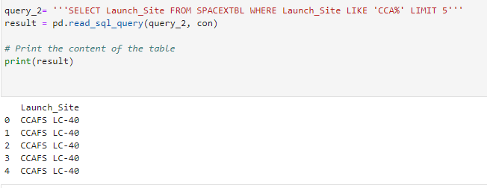
Launch Site Names Begin with 'CCA'

Slide 27
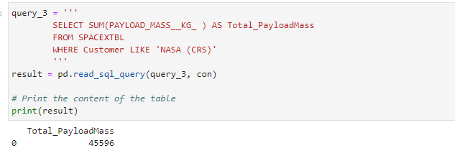
Total Payload Mass

Slide 28
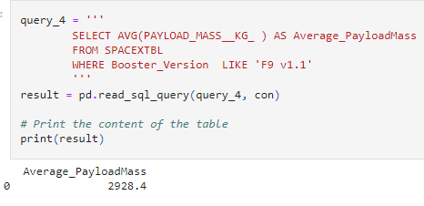
Average Payload Mass by F9 v1.1

Slide 29
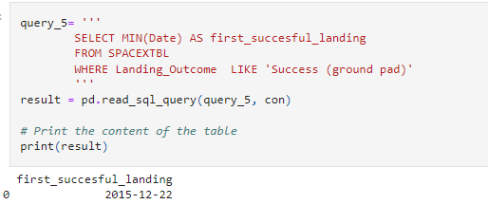
First Successful Ground Landing Date

Slide 30
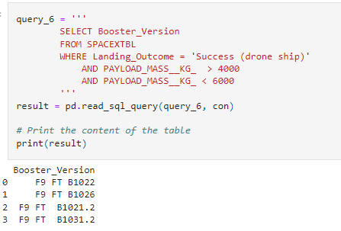
Successful Drone Ship Landing with Payload between 4000 and 6000

Slide 31
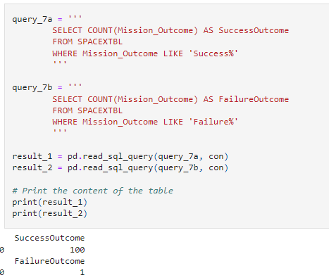
Total Number of Successful and Failure Mission Outcomes

Slide 32
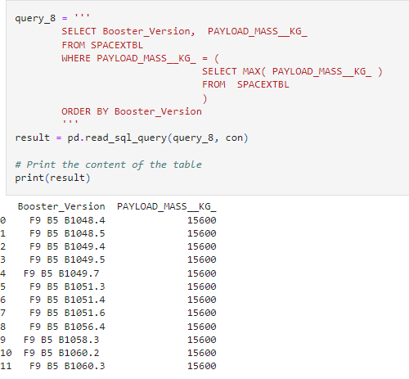
Boosters Carried Maximum Payload

Slide 33
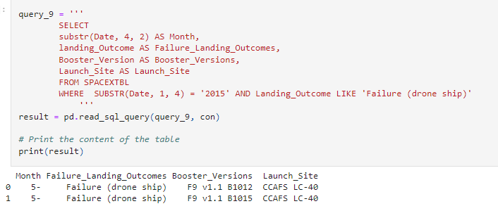
2015 Launch Records
This SQL code retrieves data from a specified table.
It extracts the month (using the provided workaround for SQLite's lack of monthnames support) and displays the month, failure landing outcomes, booster versions, and launch site for records that have a year value of 2015 in the Date column.

Slide 34
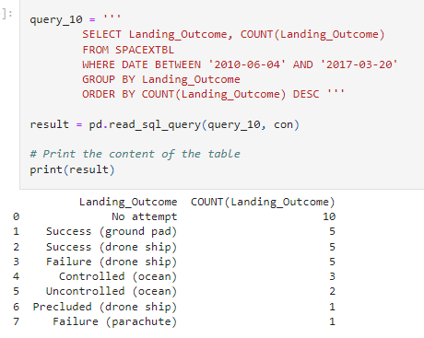
Rank Landing Outcomes Between 2010-06-04 and 2017-03-20
Selected Landing_outcomes and COUNT
of landing_outcomes from the data and
used the WHERE clause to filter for landing
outcomes BETWEEN 2010-06-04 to 2010-03-20.
Applied the GROUP BY clause to group
the landing outcomes and the ORDER BY clause to
order the grouped landing_outcome in
descending order.

Slide 35

Section 3

Slide 36
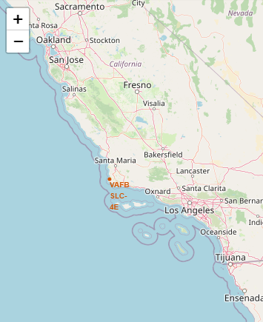
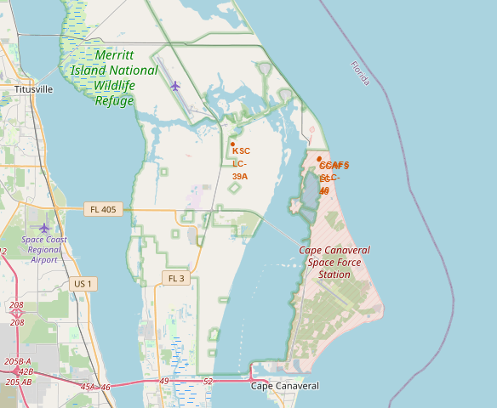
Screenshot of all launch sites’ location markers on a global map

Slide 37
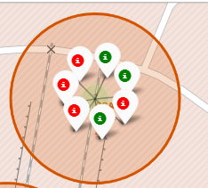
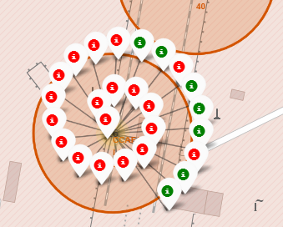
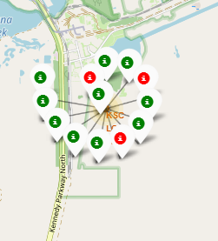
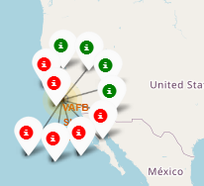
Successful and failed Lunch sites
Green markers shows the successful launches and red marker shows failure launches

Slide 38
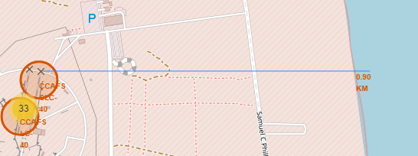
Distance to coastline
Distance to coastline

Slide 39
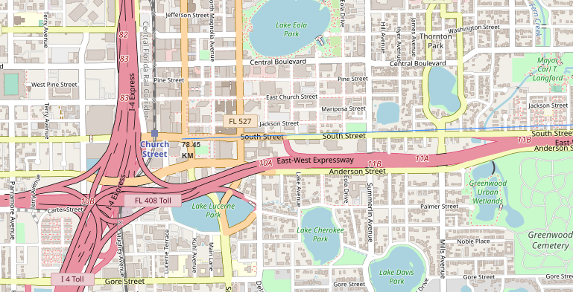
Distance to closest city

Slide 40
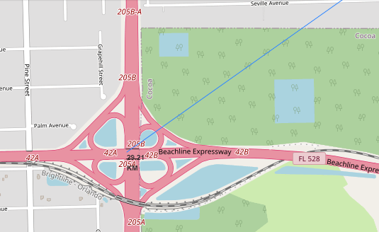
Distance to highway

Slide 41

Section 4

Slide 42
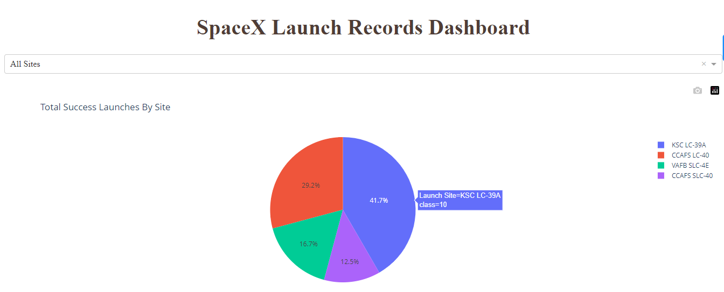
The success ratio for each four sites

Slide 43
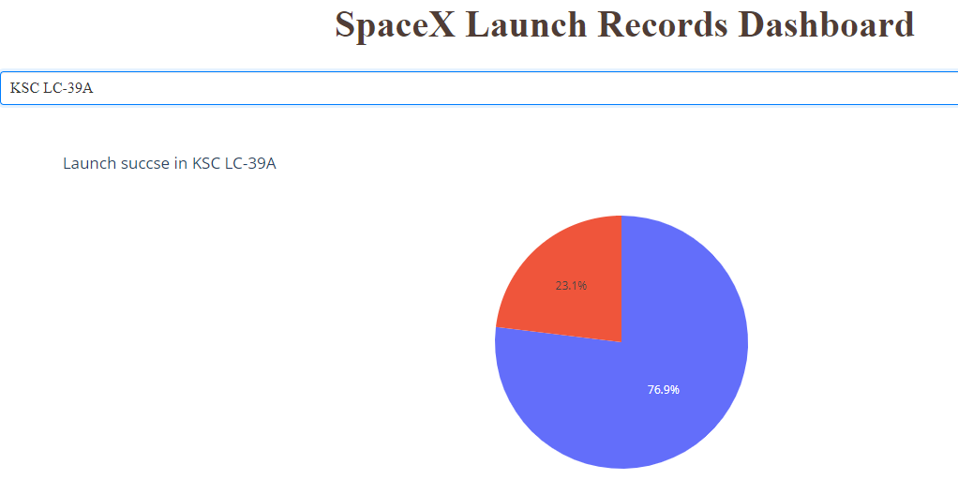
Dashboard by dash plotty
As we can see KSC LC-39A site has the most successful launch

Slide 44
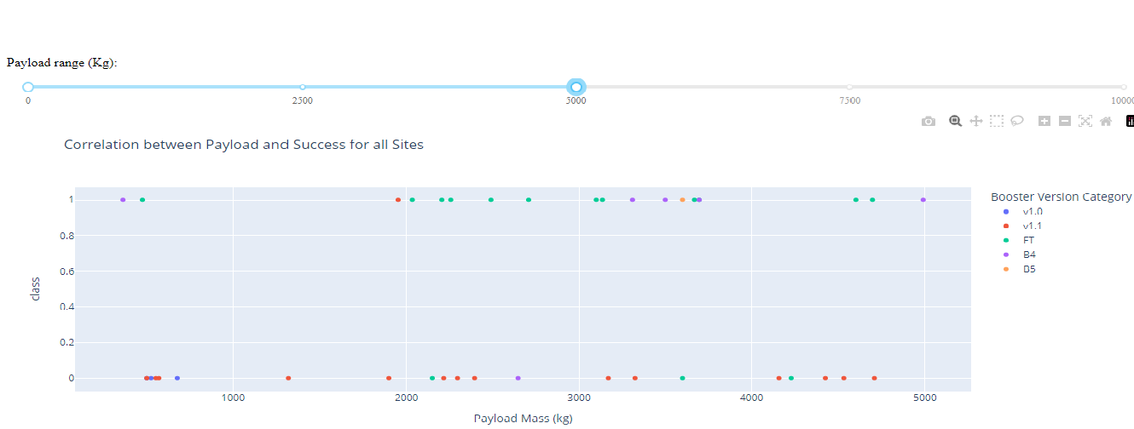
Scatter plot of Payload vs Launch Outcome for all sites
We chose different payload in the range slider (0 to 5000)

Slide 45
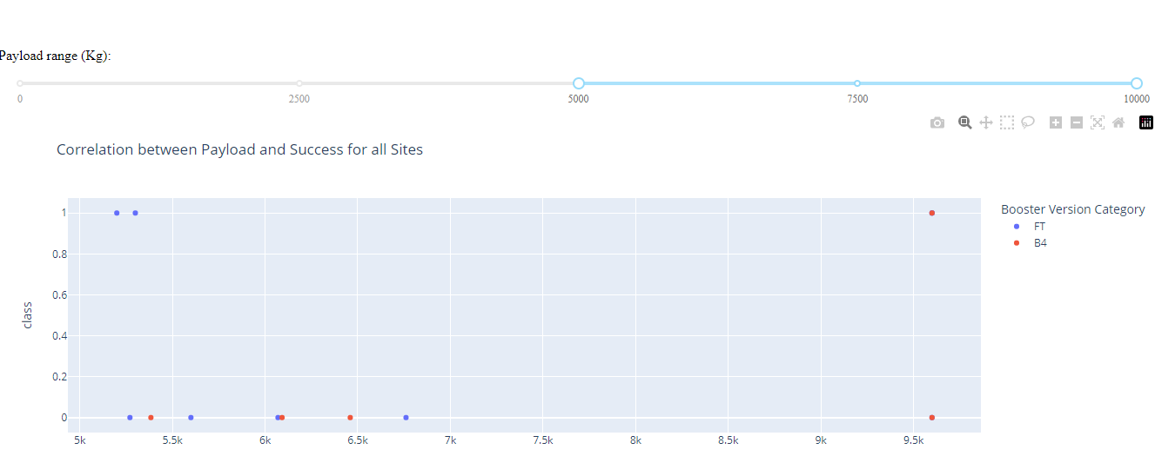
The success rate for low weight payloads 1 to 5000 is higher than high weight payload (5000 to 10000)
Github URL: https://github.com/Homa777/Applied-data-science-capston-course/blob/main/app_ploty_dash.py

Slide 46

Section 5

Slide 47
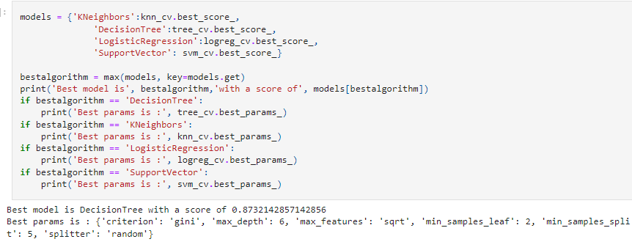
Classification Accuracy
The decision tree classifier is the model with the highest classification accuracy

Slide 48
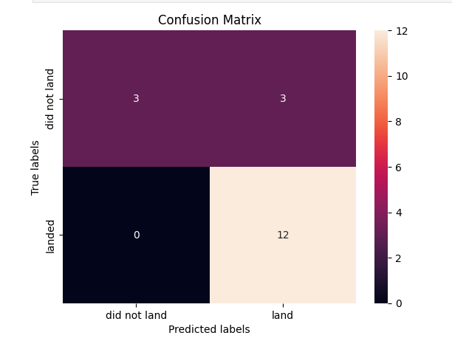
Confusion Matrix of decision
tree classifier
There are 3 cased of false positives:
The cases which did not land but
the model predicted landed.

Slide 49
Conclusion
The larger the flight amount at a launch site, the greater the success rate at a launch site.
Launch success rate started to increase in 2013 till 2020.
Orbits ES-L1, GEO, HEO, SSO, VLEO had the most success rate.
KSC LC-39A had the most successful launches of any sites.
The Decision tree classifier is the best machine learning algorithm for this task.

Slide 50


